Slide 1
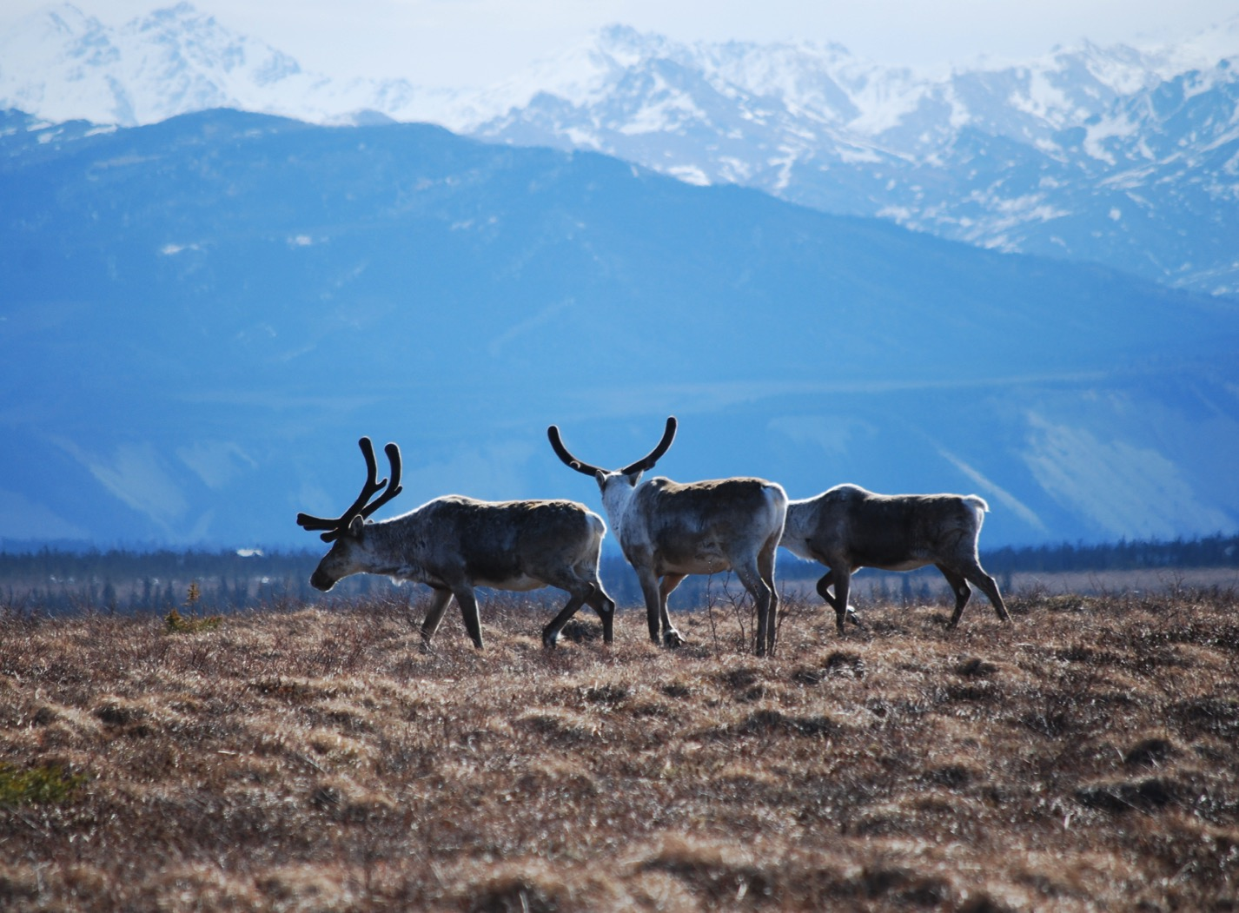
Arctic Boreal Vulnerability Experiment (ABoVE)
2017 ABoVE Airborne Campaign
14 July 2017 (DOY 195)
AVIRIS-NG: Kotzebue – Noatak – Atqasuk – Barrow
Charles Miller, Deputy Science Lead
Jet Propulsion Laboratory, California Institute of Technology
and the ABoVE Science Team For Hank Margolis, Eric Kasichke, Bruce Tagg
NASA HQ
2017

Slide 2
14 July 2017/DOY 195 Kotzebue – Noatak – Atqasuk – Barrow
Daily Status:
AVIRIS-NG / Dynamic Aviation B200 (N53W)
REPORT DATE: 14 July 2018 (Bastille Day)
Current Status of Aircraft: Yellow
Current Status of AVIRIS: GREEN
Current Deployment Location: Fairbanks AK (PAFA)
Crew: Rogers, Heidt, Nolte, Bernas
Science Coordinator: A Thorpe
Science Lead: C Miller
Project Managers: M Eastwood, I McCubbin
Instrument PI: R Green
Notes:
Aircraft avionics package continues to have intermittent loss of heading problems

Slide 3
14 July 2017/DOY 195 72-Hour Look Ahead
All plans weather dependent
Saturday 15 July 2017 (DOY 196):
Hard down day
Sunday 16 July 2017 (DOY 197):
Hard down day
Monday 17 July 2017 (DOY 198):
Seward Peninsula

Slide 4
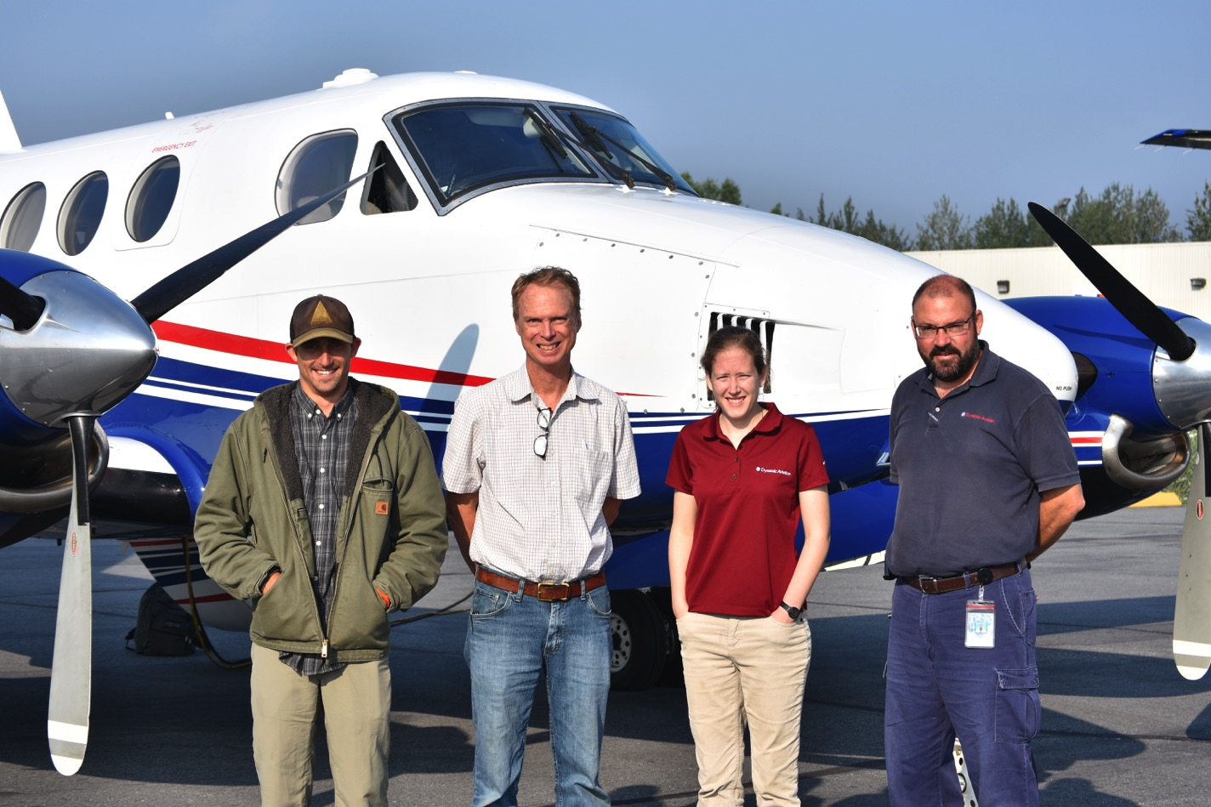

Slide 5
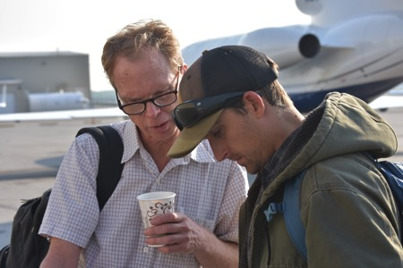
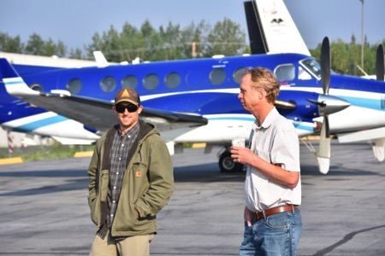
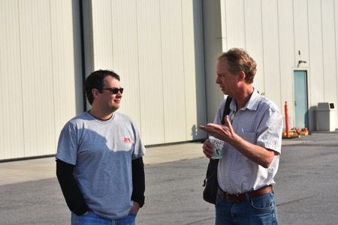
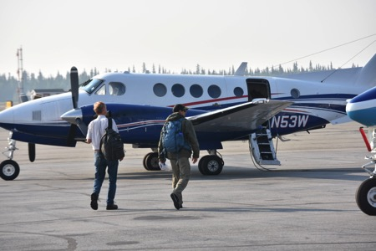
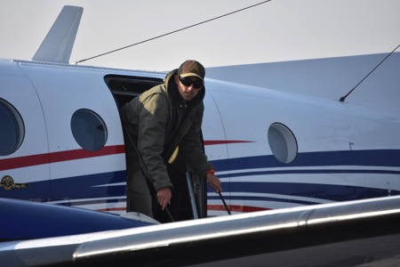
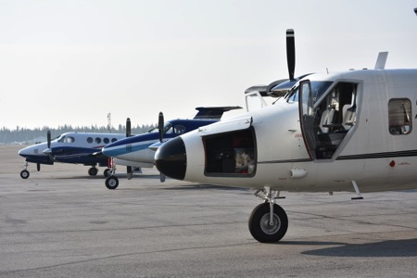
14 July 2017/DOY 195 Kotzebue – Noatak – Atqasuk – Barrow

Slide 6
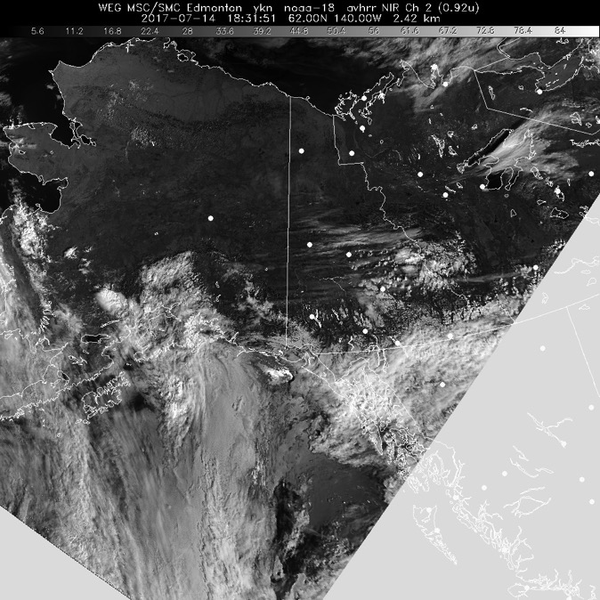
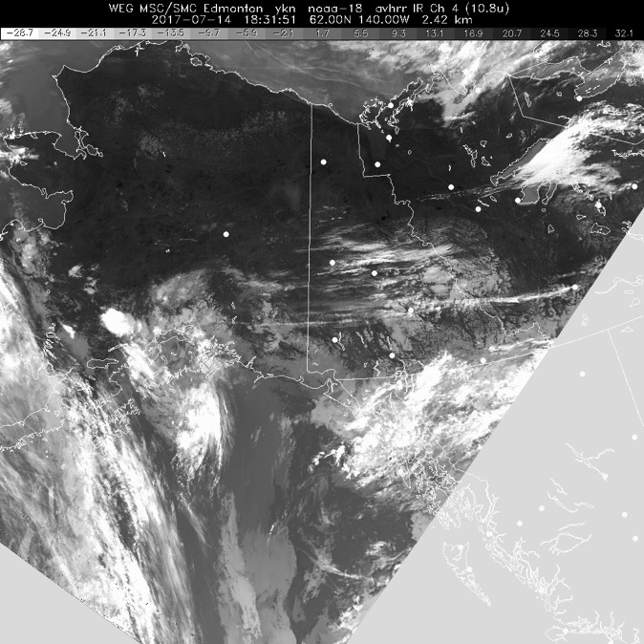
14 July 2017/DOY 195 Kotzebue – Noatak – Atqasuk – Barrow
HRPT Vis
1831Z
HRPT IR
1831Z
Clear across all of Interior and North Slope Alaska

Slide 7
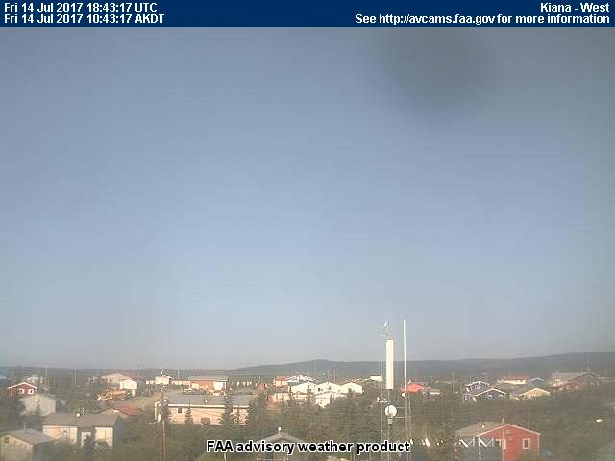
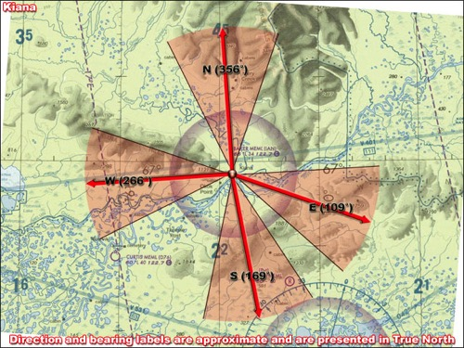
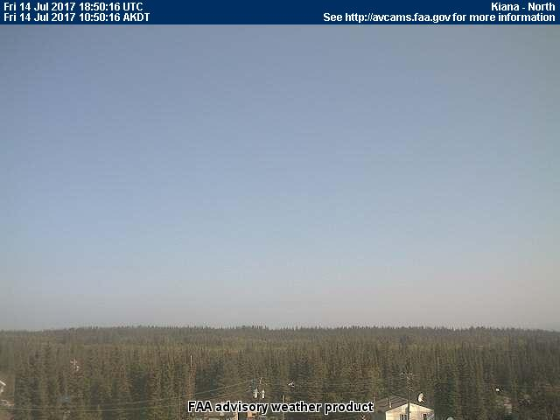
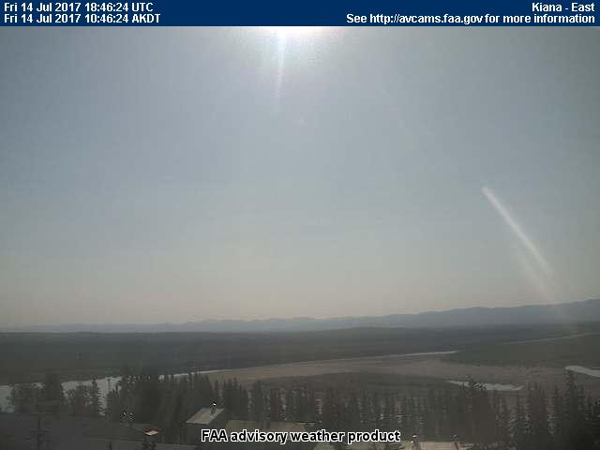
14 July 2017/DOY 195 Kotzebue – Noatak – Atqasuk – Barrow
Kiana (IAN) (PAIK)
West
North
South
East
Notes:
AVCAM sky pictures from the Deadhorse Airport (PASC) at 1325 AKDT/2125 UTC showing extreme clear conditions and the sectional coverage of each camera. The SW camera was not functioning
See http://avcams.faa.gov/ for an interactive map of Alaska aviation cameras

Slide 8
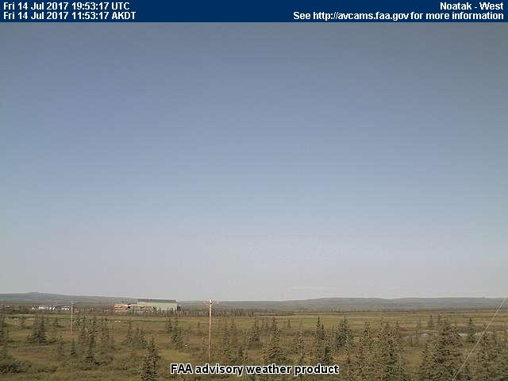
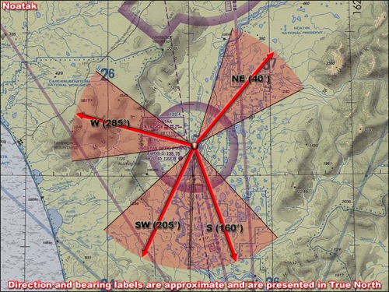
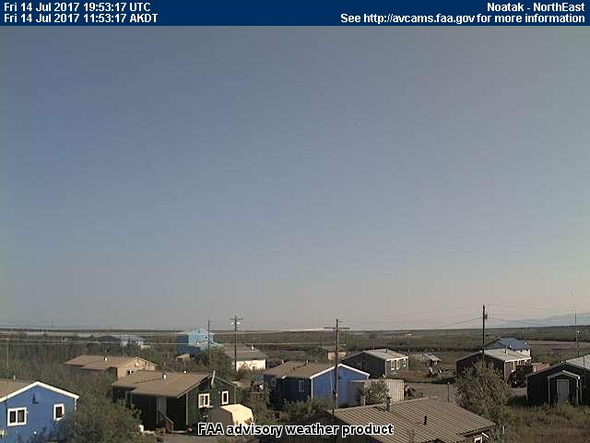
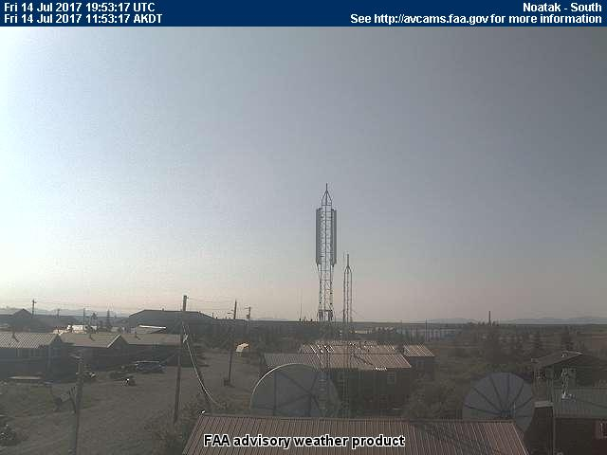
14 July 2017/DOY 195 Kotzebue – Noatak – Atqasuk – Barrow
Noatak (WTK) (PAWN)
West
Northeast
Southwest
South
Notes:
AVCAM sky pictures from the Deadhorse Airport (PASC) at 1325 AKDT/2125 UTC showing extreme clear conditions and the sectional coverage of each camera. The SW camera was not functioning
See http://avcams.faa.gov/ for an interactive map of Alaska aviation cameras

Slide 9
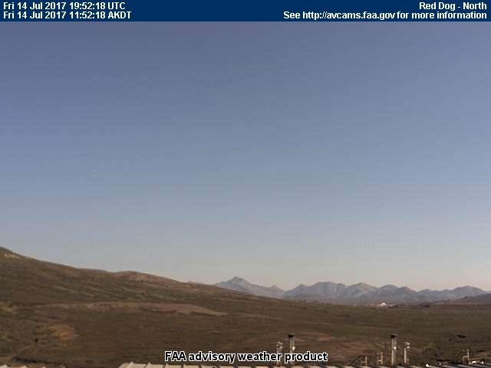
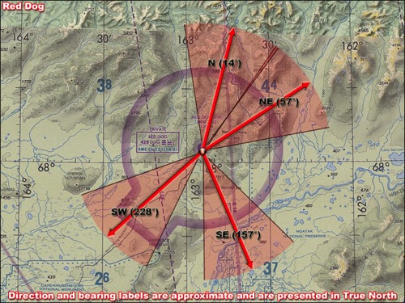
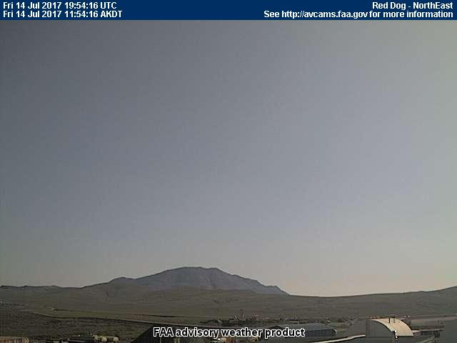
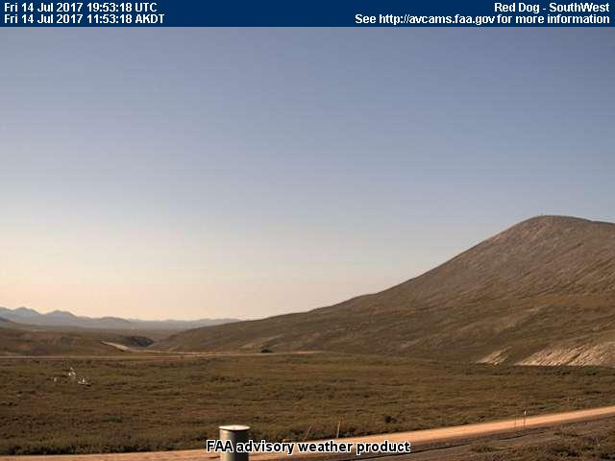
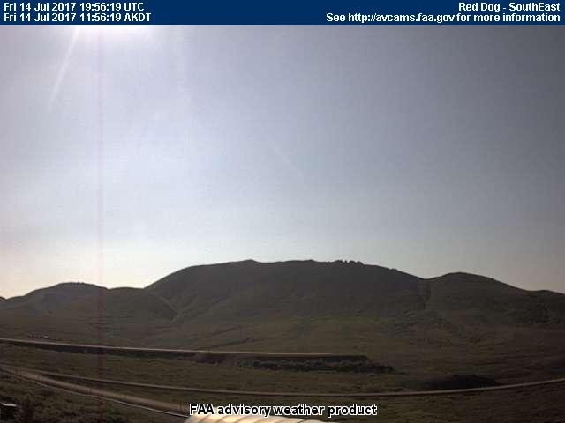
14 July 2017/DOY 195 Kotzebue – Noatak – Atqasuk – Barrow
Red Dog Mine (DGG) (PADG)
North
Northeast
Southwest
Southeast
Notes:
AVCAM sky pictures from the Deadhorse Airport (PASC) at 1325 AKDT/2125 UTC showing extreme clear conditions and the sectional coverage of each camera. The SW camera was not functioning
See http://avcams.faa.gov/ for an interactive map of Alaska aviation cameras

Slide 10
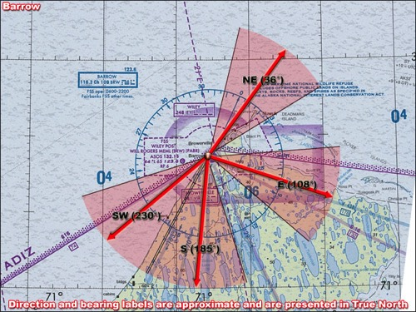
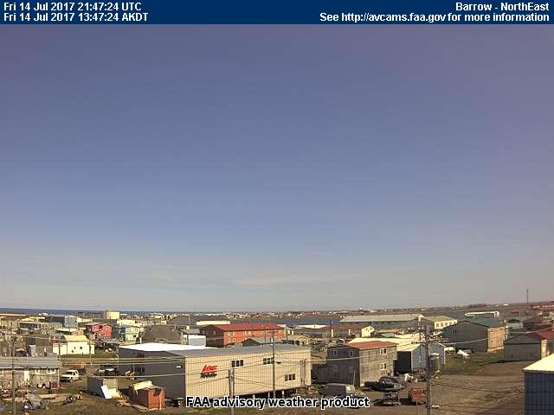
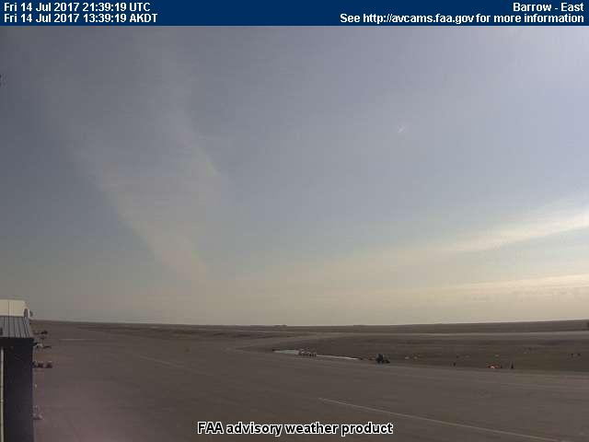
14 July 2017/DOY 195 Kotzebue – Noatak – Atqasuk – Barrow
Barrow (BRW) (PABR)
Southwest
Northeast
South
East
Notes:
AVCAM sky pictures from the Deadhorse Airport (PASC) at 1325 AKDT/2125 UTC showing extreme clear conditions and the sectional coverage of each camera. The SW camera was not functioning
See http://avcams.faa.gov/ for an interactive map of Alaska aviation cameras

Slide 11
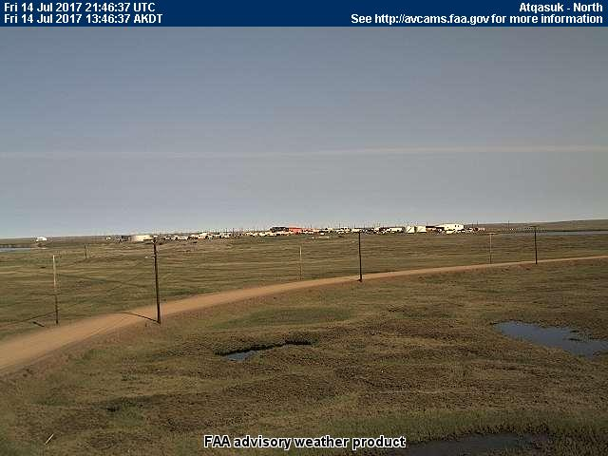
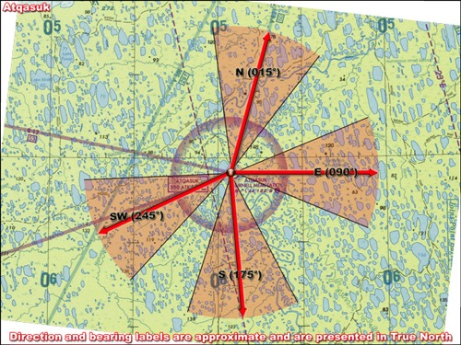
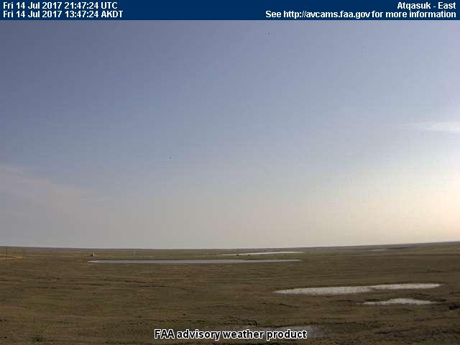
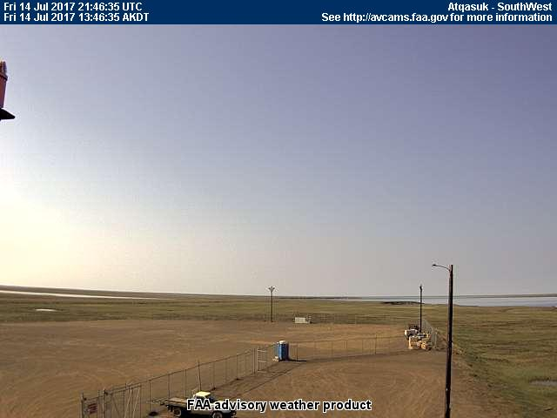
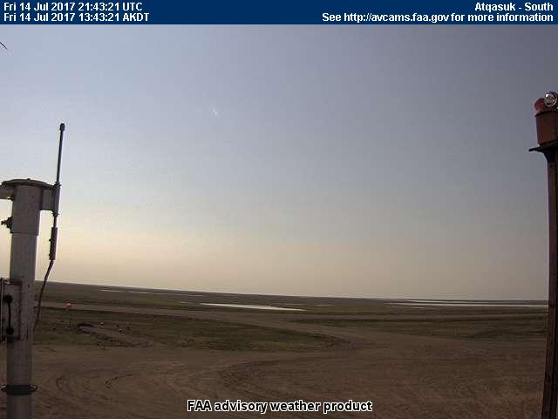
14 July 2017/DOY 195 Kotzebue – Noatak – Atqasuk – Barrow
Atqasuk (ATK) (PATQ)
North
East
Southwest
South
Notes:
AVCAM sky pictures from the Deadhorse Airport (PASC) at 1325 AKDT/2125 UTC showing extreme clear conditions and the sectional coverage of each camera. The SW camera was not functioning
See http://avcams.faa.gov/ for an interactive map of Alaska aviation cameras

Slide 12
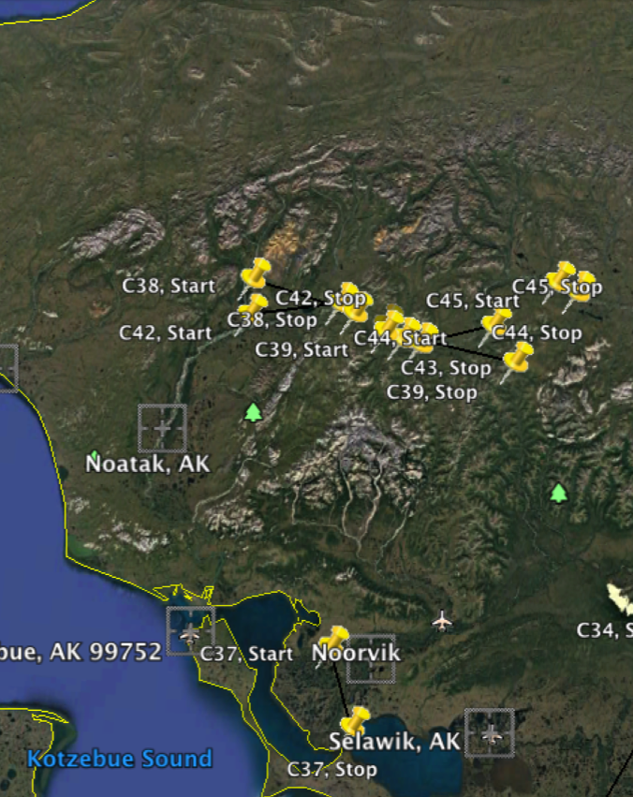
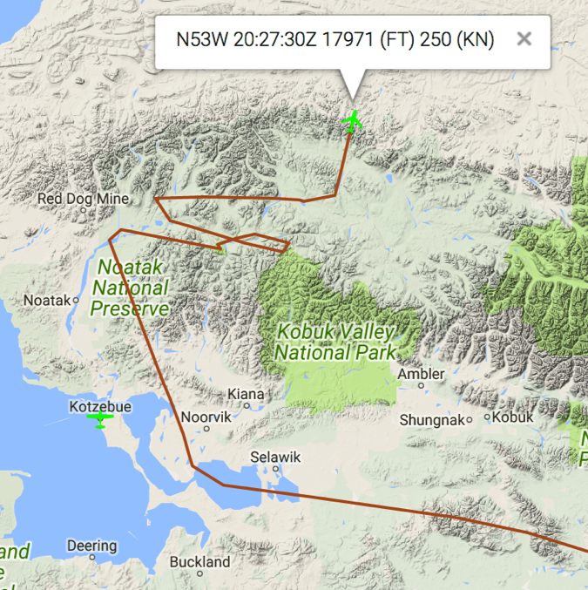
14 July 2017/DOY 195 Kotzebue – Noatak – Atqasuk – Barrow
Planned flight lines:
Noorvik – Noatak
As-flown Lines

Slide 13
14 July 2017/DOY 195 Kotzebue – Noatak – Atqasuk – Barrow
AVIRIS-NG Quick-look products
https://avirisng.jpl.nasa.gov/cgi/flights.cgi?step=view_flightlog&flight_id=ang20170714t
A. Bonus Line, Run ID 183042:
B. Line C37, Track Air #194, Run ID 184714: Noorvik
Winston Olson-Duvall, JPL
A
B
A. Lakes and wetlands along the Norton Sound
B. Noorvik area wetlands have a high concentration of methane ebullition lakes

Slide 14
14 July 2017/DOY 195 Kotzebue – Noatak – Atqasuk – Barrow
AVIRIS-NG Quick-look products
https://avirisng.jpl.nasa.gov/cgi/flights.cgi?step=view_flightlog&flight_id=ang20170714t
A. Line C42, Track Air #199, Run ID 191123: Noatak 1
B. Line C43, Track Air #200, Run ID 192043: Noatak 2
Winston Olson-Duvall, JPL
A
B
A. Lakes and wetlands along the Mackenzie River Valley
B. Imagery of the Noatak River

Slide 15
14 July 2017/DOY 195 Kotzebue – Noatak – Atqasuk – Barrow
AVIRIS-NG Quick-look products
https://avirisng.jpl.nasa.gov/cgi/flights.cgi?step=view_flightlog&flight_id=ang20170714t
A. Line C44, Track Air #201, Run ID 192619: Noatak burn survey
B. Line C39, Track Air #196, Run ID 193527: Noatak burn survey
Winston Olson-Duvall, JPL
A
B
A. Lakes and wetlands along the Mackenzie River Valley
B. Significant cloud cover encountered before getting to Scotty Creek flux towers – will need to refly

Slide 16
14 July 2017/DOY 195 Kotzebue – Noatak – Atqasuk – Barrow
AVIRIS-NG Quick-look products
https://avirisng.jpl.nasa.gov/cgi/flights.cgi?step=view_flightlog&flight_id=ang20170714t
A. Line C38, Track Air #195, Run ID 194611: Noatak burn survey
B. Bonus Line, Run ID 200532: TBD
Winston Olson-Duvall, JPL
A
B
A. Lakes and wetlands along the Mackenzie River Valley
B. Excessive cloud cover

Slide 17
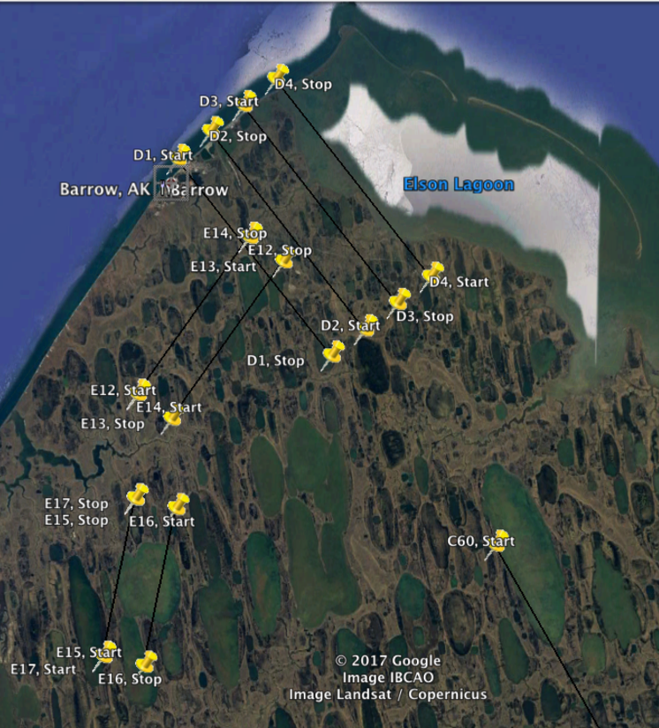
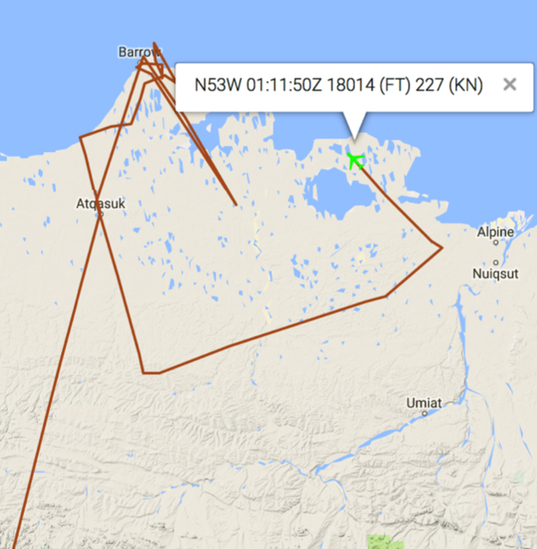
14 July 2017/DOY 195 Kotzebue – Noatak – Atqasuk – Barrow
Planned flight lines & acquisition segments: Barrow
As-flown Lines
E13/303
E14/304
D4/225
D3/224
D2/223
D1/222
E16/306
E17/307
C60/217
Notes:
Glitches in as-flown flight lines due to intermittent tracker drop outs

Slide 18
14 July 2017/DOY 195 Kotzebue – Noatak – Atqasuk – Barrow
AVIRIS-NG Quick-look products
https://avirisng.jpl.nasa.gov/cgi/flights.cgi?step=view_flightlog&flight_id=ang20170714t
A. Line C45, Track Air #202, Run ID 201641: Noatak burn survey
B. Line C61, Track Air #218, Run ID 205712: Atqasuk – Arctic Coast
Winston Olson-Duvall, JPL
A
B
A. C45 is planned as a short line compared to others
B. Brilliant blue of the Arctic Ocean seen at left of this image

Slide 19
14 July 2017/DOY 195 Kotzebue – Noatak – Atqasuk – Barrow
AVIRIS-NG Quick-look products
https://avirisng.jpl.nasa.gov/cgi/flights.cgi?step=view_flightlog&flight_id=ang20170714t
A. Line E15, Track Air #305, Run ID 211031: Sukok Lake
B. Line E16, Track Air #306, Run ID 211620: Sukok Lake
Winston Olson-Duvall, JPL
A
B
A.& B. Brilliant green swirling biota in Sukok Lake, one of the largest methane ebullition sites yet identified in Alaska
Notes:
B direction gives more vivid tundra land surface coloring. Sun angle?

Slide 20
14 July 2017/DOY 195 Kotzebue – Noatak – Atqasuk – Barrow
AVIRIS-NG Quick-look products
https://avirisng.jpl.nasa.gov/cgi/flights.cgi?step=view_flightlog&flight_id=ang20170714t
A. Line E13, Track Air #303, Run ID 212331: Pipeline Lake
B. Line E14, Track Air #304, Run ID 212855: Pipeline Lake
Winston Olson-Duvall, JPL
A
B
A. & B. Ikroavik Lake (Pipeline Lake), a large methane ebullition source

Slide 21
14 July 2017/DOY 195 Kotzebue – Noatak – Atqasuk – Barrow
AVIRIS-NG Quick-look products
https://avirisng.jpl.nasa.gov/cgi/flights.cgi?step=view_flightlog&flight_id=ang20170714t
A. Line D4, Track Air #225, Run ID 214452: Barrow Grid
B. Line D3, Track Air #224, Run ID 213741: Barrow Grid
Winston Olson-Duvall, JPL
A
B
A. Barrow town seen in the left-hand edge of the image, dominated by drained lakebeds
B. Rippling waves of low clouds obscure this image

Slide 22
14 July 2017/DOY 195 Kotzebue – Noatak – Atqasuk – Barrow
AVIRIS-NG Quick-look products
https://avirisng.jpl.nasa.gov/cgi/flights.cgi?step=view_flightlog&flight_id=ang20170714t
A. Line C60, Track Air #217, Run ID 232619: Lake Tusikovak (SE of Barrow)
Winston Olson-Duvall, JPL
A
A. Bright green and milky green waters seen in the 2 large lakes of this image

Slide 23
14 July 2017/DOY 195 Kotzebue – Noatak – Atqasuk – Barrow
AVIRIS-NG Quick-look products
https://avirisng.jpl.nasa.gov/cgi/flights.cgi?step=view_flightlog&flight_id=ang20170714t
A. Line D2, Track Air #223, Run ID 235124: Barrow Grid
B. Line D1, Track Air #222, Run ID 234307: Barrow Grid
Winston Olson-Duvall, JPL
A
B
A. Barrow town seen in the left-hand edge of the image, dominated by drained lakebeds
B. Rippling waves of low clouds obscure this image

Slide 24
14 July 2017/DOY 195 Kotzebue – Noatak – Atqasuk – Barrow
AVIRIS-NG Quick-look products
https://avirisng.jpl.nasa.gov/cgi/flights.cgi?step=view_flightlog&flight_id=ang20170715t
A. Line C55, Track Air #212, Run ID 000804: ATQ flux tower; CALM Atqasuk
B. Line C59, Track Air #216, Run ID 001841: South of Atqasuk
Winston Olson-Duvall, JPL
A
B
A. Atqasuk and numerous green lakes imaged
B. Large clouds at the end of this image

Slide 25
14 July 2017/DOY 195 Kotzebue – Noatak – Atqasuk – Barrow
AVIRIS-NG Quick-look products
https://avirisng.jpl.nasa.gov/cgi/flights.cgi?step=view_flightlog&flight_id=ang20170715t
A. Line C56, Track Air #213, Run ID 011416: CALM Drew Point/Arctic coast @ Smith Bay
B.
Winston Olson-Duvall, JPL
A
A. Atqasuk and numerous green lakes imaged
B.

Slide 26
14 July 2017/DOY 195 Kotzebue – Noatak – Atqasuk – Barrow
A
Notes:
Barrow area composite
Clouds dampen the relative land surface brightness in the lower 2 images

Slide 27
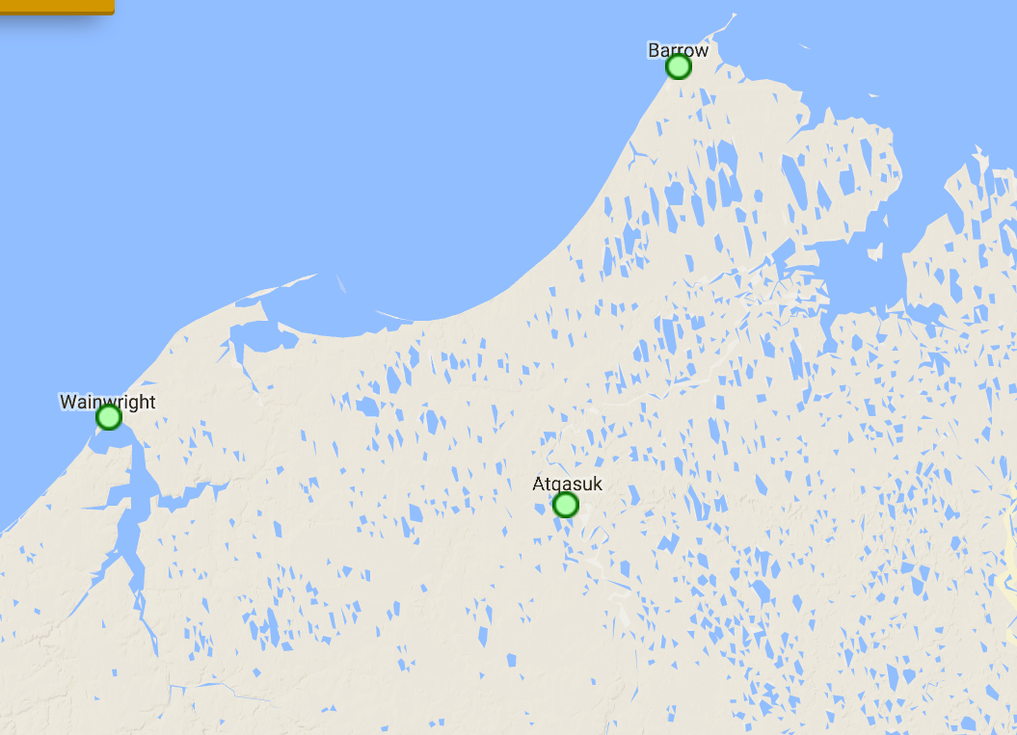
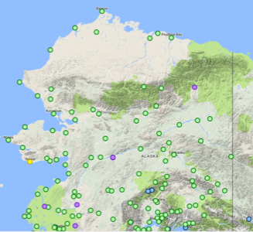
Seward Peninsula Area FAA Webcamera Locations

